Slide 1

Introduction to Database Management System (DBMS)
Presented by: Jaiwanthy V
CSA0506 – Database Management System
Technical Presentation

Slide 2
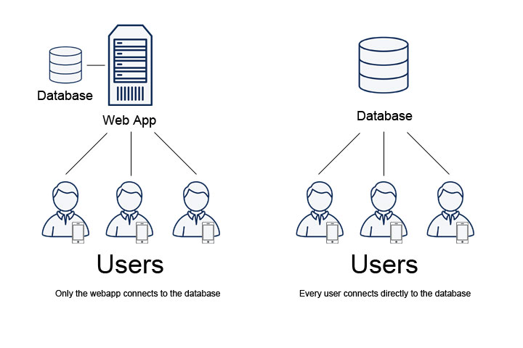
What is DBMS?
A Database Management System (DBMS) is software that allows users to create, store, retrieve, update, and manage data efficiently in a structured manner.
Key Functions
Stores large amounts of data
Organizes data into tables
Performs CRUD operations (Create, Read, Update, Delete)
Ensures data security and integrity
Supports multiple users simultaneously
Examples
MySQL, Oracle Database, Microsoft SQL Server, PostgreSQL, MongoDB

Slide 3
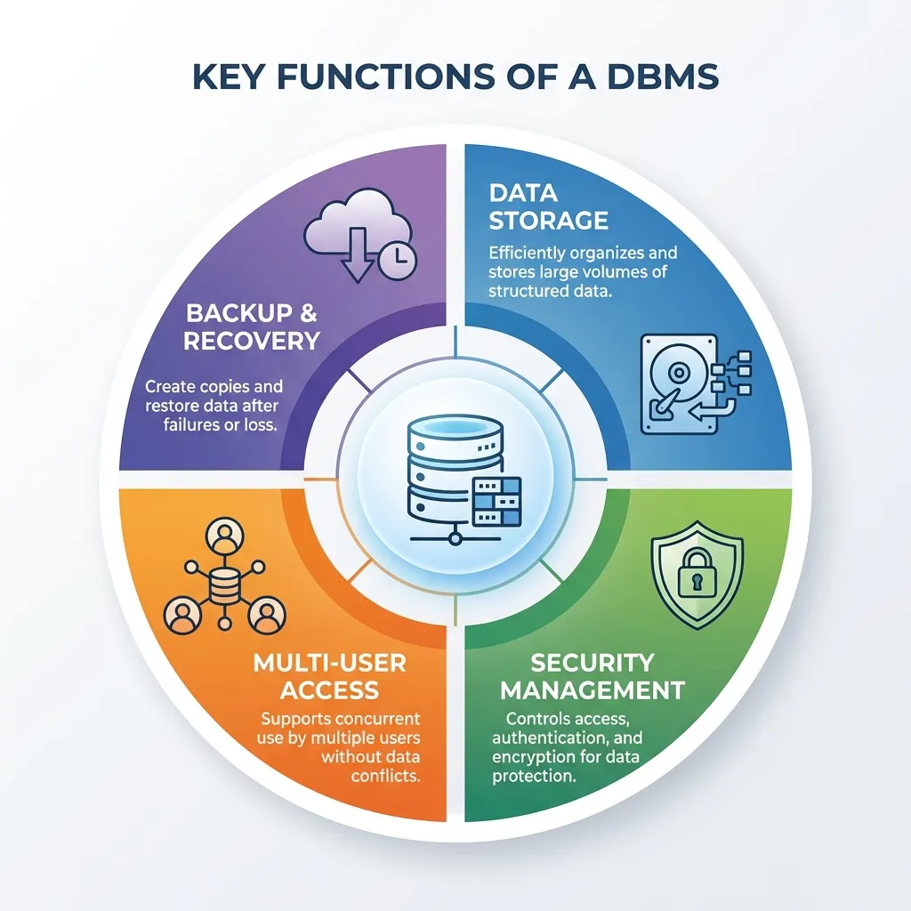
Objectives of DBMS
Reduce data redundancy
Ensure data consistency
Improve data security
Enable data sharing
Provide efficient data retrieval
Support backup and recovery
Maintain data integrity
Allow concurrent access by multiple users

Slide 4
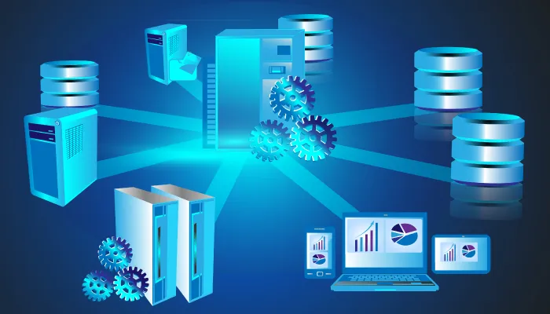
Advantages of DBMS
Reduces duplicate data
Faster data access
Better security using authentication
Easier backup and recovery
Supports multiple users
Improves data accuracy
Centralized data management
Simplifies application development

Slide 5
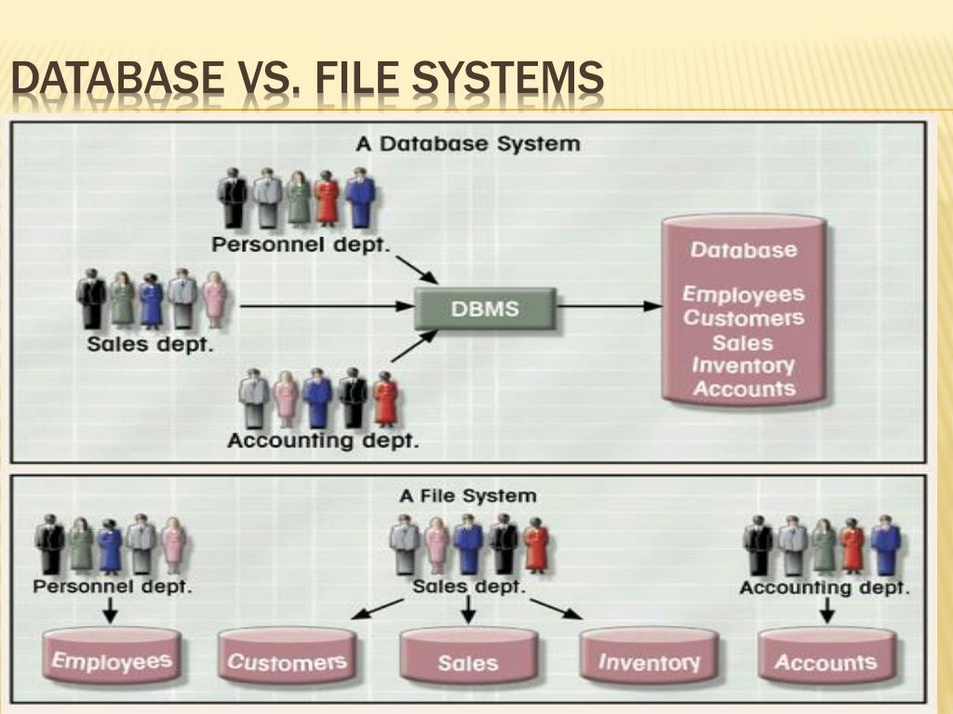

Slide 6
Conclusion
DBMS provides an efficient way to store, organize, and manage data.
It reduces data redundancy and ensures data consistency.
It offers high security, data integrity, and backup & recovery features.
It supports multiple users with concurrent access to the same database.
DBMS enables fast and accurate data retrieval for decision-making.
It is widely used in banking, healthcare, education, e-commerce, and other industries.
Overall, a DBMS is an essential technology for managing large volumes of data efficiently, securely, and reliably.

Slide 7
THANK YOU

